Slide 1
WIPRO NGA PROGRAM
CAPSTONE PROJECT – 12 AUGUST 2024
PROJECT TITLE – MULTITHREADED BANKING SYSTEM
PRESENTED BY – DEEPAK P

Slide 2
PROJECT OVERVIEW
The project aims to show how to manage concurrent access to shared resources, in this case bank accounts, using mutexes and multithreading. The code that is provided creates a straightforward multithreaded banking system. In the simulation, numerous threads randomly make deposits and withdrawals from a set of bank accounts while using mutexes to maintain thread safety.

Slide 3
SCOPE
The scope of this project is to create a multithreaded banking simulation where multiple threads perform random transactions (deposits and withdrawals) on shared bank accounts, ensuring data consistency through mutexes. The project includes initializing accounts, managing transactions concurrently, handling errors, and reporting the final transaction statistics.
Why MultiThreading and mutex:
Concurrency
Data consistency

Slide 4
MOTIVATION
The project’s primary motivation is to simulate a multi-threaded banking system where multiple threads perform concurrent transactions on a shared set of accounts.
Concurrency Management
Thread Synchronization
Real-World Applications

Slide 5
FUNCTIONS
initialize_accounts()
deposit(Account *account, int amount)
withdraw(Account *account, int amount)
transaction(void *arg)
pthread_create()
pthread_join()
pthread_mutex_lock()
pthread_mutex_unlock()

Slide 6
pthread_mutex_init()
pthread_mutex_destroy()
malloc()
free()
rand()
srand()

Slide 7
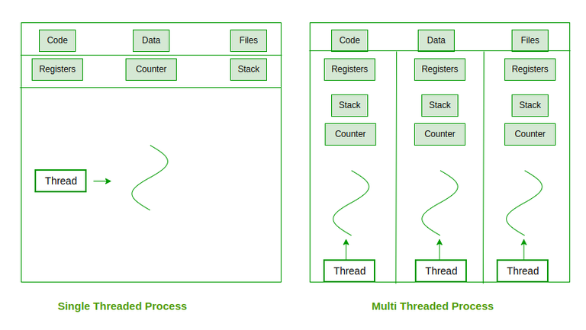

Slide 8
FUTURE AMENDMENTS ADDRESSING COMMON CHALLENGES
Concurrency Issues:
Challenge: Multiple threads accessing shared data can cause race conditions and inconsistent results.
Amendment: Use mutexes to protect access to shared data (e.g., account balances, global totals).
Error Handling:
Challenge: Issues like memory allocation failures or mutex initialization errors can crash the program.

Slide 9
Amendment: Add comprehensive error checking and handle failures gracefully.
Deadlocks:
Challenge: Threads could end up waiting indefinitely for each other to release locks.
Amendment: Ensure that locks are acquired and released in a consistent order, and avoid nested locking where possible.

Slide 10
